Slide 1
COMMERCE –III ( MF)
Dr. Sumita Shankar

Slide 2

PLANNING

Slide 3
PLANNING- INTRODUCTION
What to do?
How to do?
When to do?
Who is to do it? and
What is the cost?

Slide 4
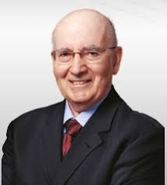
DEFINITION OF PLANNING
Philip Kotler “planning is deciding in the present what to do in the future. It is the process whereby companies reconcile their objectives and opportunities”

Slide 5
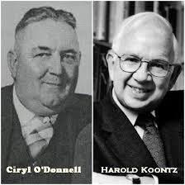
DEFINITION OF PLANNING
Koontz and O’Donnell – “Planning is deciding in advance what to do, when to do, how to do and who is to do it. It is bridging the gap from where we are to where we want to go.”

Slide 6
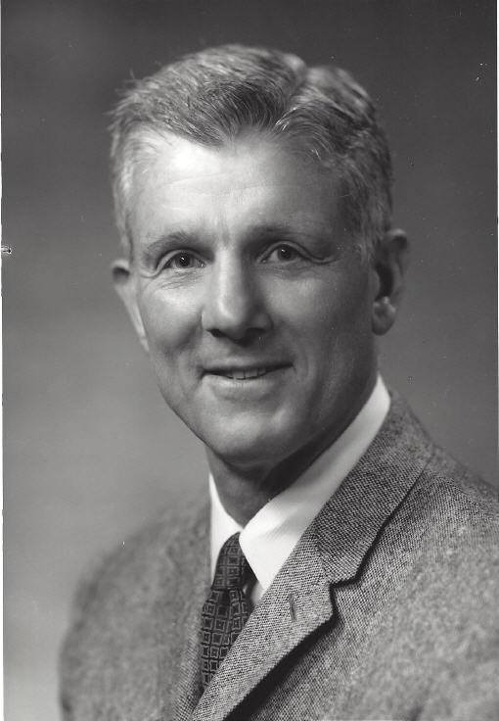
DEFINITION OF PLANNING
Louis A. Allen – “Management planning involves the development of forecasts, objectives, policies, programmes, procedures, schedules and budgets.”

Slide 7

FEATURES OF PLANNING

Slide 8

FEATURES OF PLANNING
. 1. Intellectual Process

Slide 9

FEATURES OF PLANNING
2. Goal Oriented

Slide 10
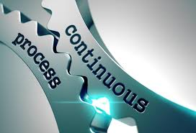
FEATURES OF PLANNING
3. Continous Process

Slide 11

FEATURES OF PLANNING
4. All pervasive

Slide 12

FEATURES OF PLANNING
5. Primary Function

Slide 13

FEATURES OF PLANNING
6. Forward looking Nature

Slide 14

FEATURES OF PLANNING
7. Flexibility

Slide 15
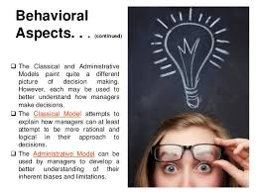
FEATURES OF PLANNING
8. Decision-Making Aspect

Slide 16
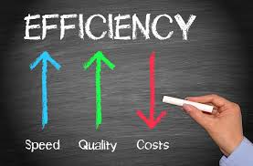
FEATURES OF PLANNING
9.Efficiency

Slide 17
ADVANTAGES OF PLANNING
1. Planning helps in achievement of objectives
2. Planning minimizes uncertainties

Slide 18
ADVANTAGES OF PLANNING
3. Planning facilitates co-ordination
4. Planning encourages innovations

Slide 19
ADVANTAGES OF PLANNING
5. . Planning facilitates controlling.
6. Planning provides competitive edge

Slide 20
ADVANTAGES OF PLANNING
7. Planning improves employee’s moral.

Slide 21
LIMITATIONS OF PLANNING
Lack of reliable data
Time consuming
3. Expensive

Slide 22
LIMITATIONS OF PLANNING
4. Resistance to change
5. Sudden Emergencies
6. External factors may reduce Utility

